Slide 1
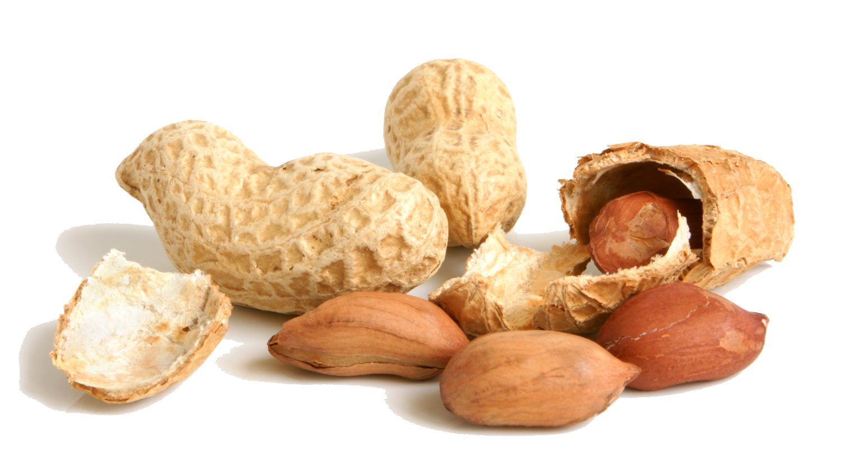
Newark Nut Company
Business Solution Plan
Ryan Nguyen & Hai Tran

Slide 2
Company Background
Newark Nut Company is a business that sells a variety of nuts and dried fruits.
Their first store was established in 1929 by founder Sol Braverman. This was an open-air market in New Jersey.
In 1999 Mr. Braverman established his “NutsOnline.com” domain name. The website remained dormant since its creation.
The business thrived and then faded in 2002.
The company was later operated out of a downtown mall.

Slide 3
Current
The Newark Nut Company has now taken an online direction as Mr. Braverman’s grandson, Jefferey Braverman, joined the business in 2003.
Shifted the company's focus towards an online business.
The online store has seen increased revenue.

Slide 4
Challenges
The Newark Nut Company’s domain name “Nutsonline.com” was viewed as awkward by the owner. He changed it to a purchasable domain name "Nuts.com".
The domain name change caused a drop in revenue and website visits.
The transition caused major frustration and concern for Mr. Braverman.
Mr. Braverman is currently seeking ways to improve the transition.

Slide 5
Solutions
Paid Google Ads
Social Media Advertisement

Slide 6
Paid Google Ads Pros & Cons
You can reach a large audience
Keyword marketing
Only paying for clicks
Can be seen through many Google platforms
High value keywords are competitive
Learning curve
It can get expensive

Slide 7
Social Media Advertising Pros & Cons
Familiarity
Cost effectiveness
Supporting content
Reaching new audiences
Higher quality ads
Competition
Constant monitoring
Education

Slide 8
Conclusion: Social Media Advertising
Traction on the Nuts.com will pick up eventually after the domain change from NutsOnline.com. This is common in domain name changes.
During the waiting phase of the domain change. Social media advertisements can be established. Also, Newark Nut Company partners can update their websites with new website links.
As the domain catches up and regains traffic. Social media ads will introduce new people to the company. This will expand the reach and gain potentially new customers.

Slide 9
Thank You! Questions

Slide 10
Resources
https://www.kunocreative.com/blog/google-adwords-advertising-pros-and-cons
https://www.hostgator.com/blog/google-ads-pros-cons-small-business/
https://thrivehive.com/social-media-advertising-pros-and-cons/

